Slide 1


PROGRAM:
BUDGET TRACKER

Slide 2
GROUP 1
MEMBERS
SIMON PATRICK P. LAPUZ
BIEN MACARAEG
GIAN CARLO VERUEN
THEA PADILLA

Slide 3
COURSE & SECTION:
CPE007-CPE11S6

Slide 4
INSTRUCTOR:
ENGR. ROBIN VALENZUELA

Slide 5


OBJECTIVES
To allow the user to input their monthly income, expenses, and spending limit
Calculate how much the user will have saved based on their monthly income and spending limit
To allow the user to calculate reduced spending based on percentage for them to see how much they can save instead

Slide 6

STATEMENT OF
THE PROBLEM
As we all know, managing our finances may prove to be quite a challenge. Many people often have difficulties keeping track of their monthly savings and expenses which usually leads to poor management of their finances. In order to give these people a helping hand, our group will be developing a C++ program that allows users to efficiently track their monthly savings and expenses.

Slide 7
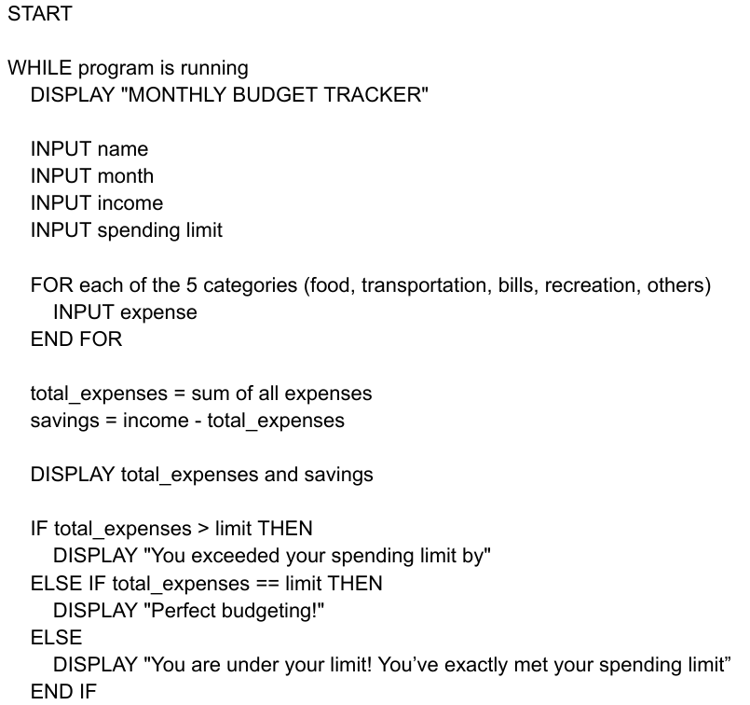
PSEUDOCODE

Slide 8
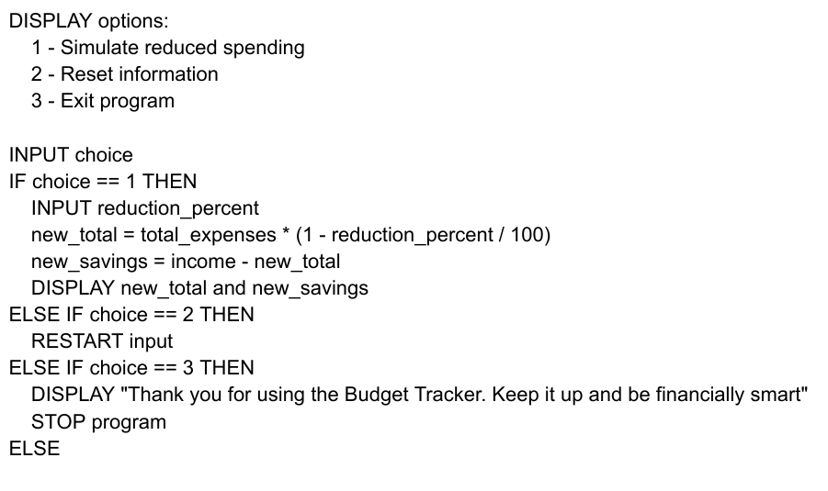
PSEUDOCODE

Slide 9
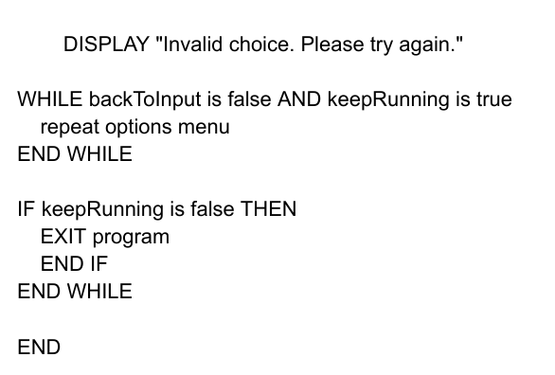
PSEUDOCODE

Slide 10

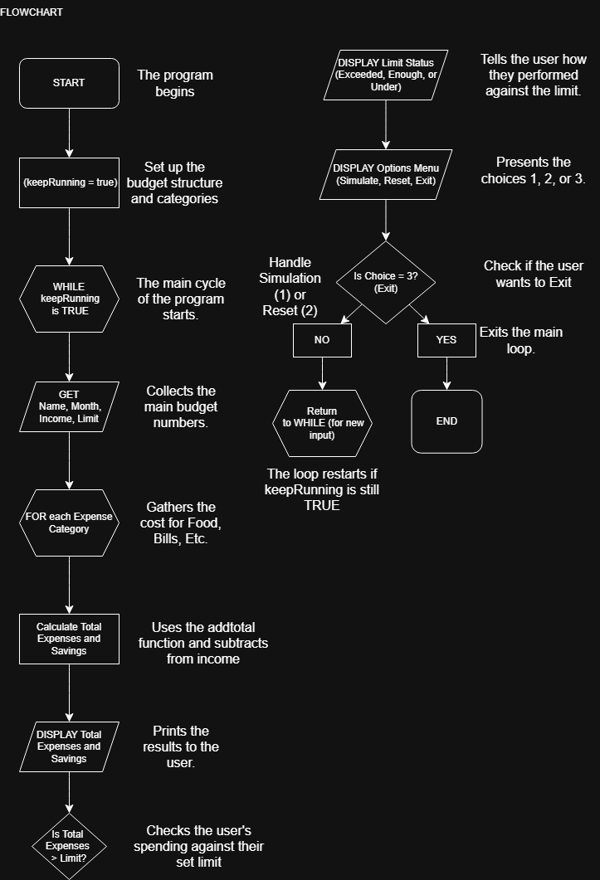
FLOWCHART

Slide 11
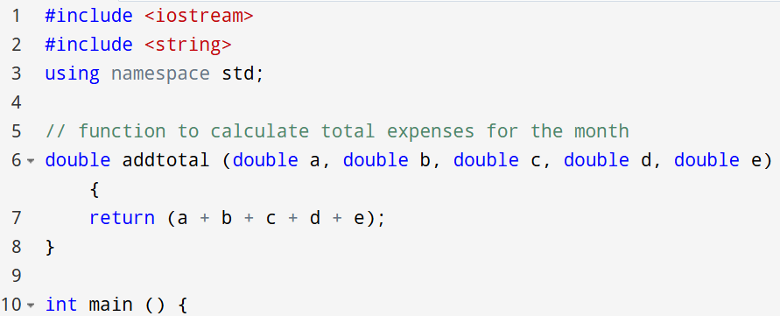
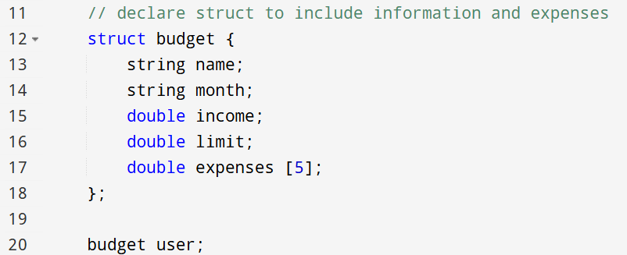
PROGRAM

Slide 12
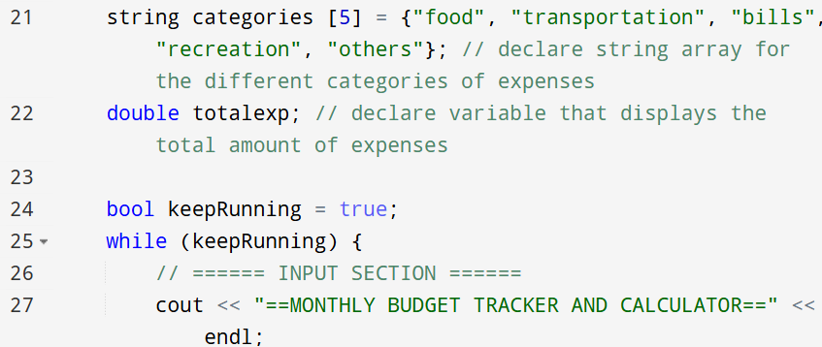
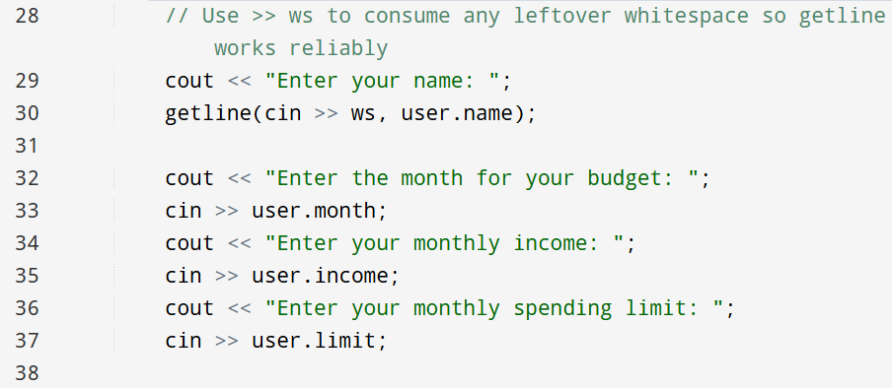
PROGRAM

Slide 13
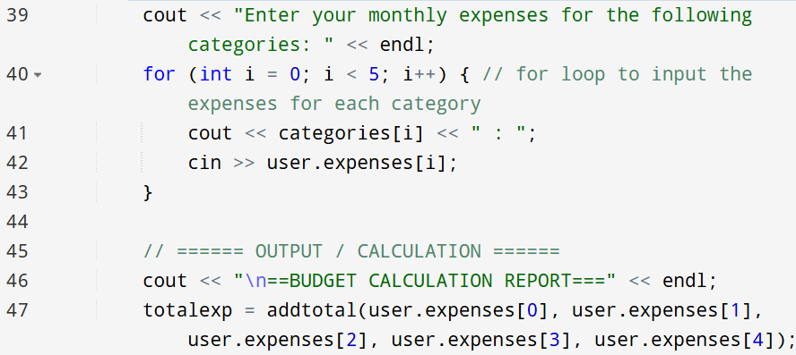
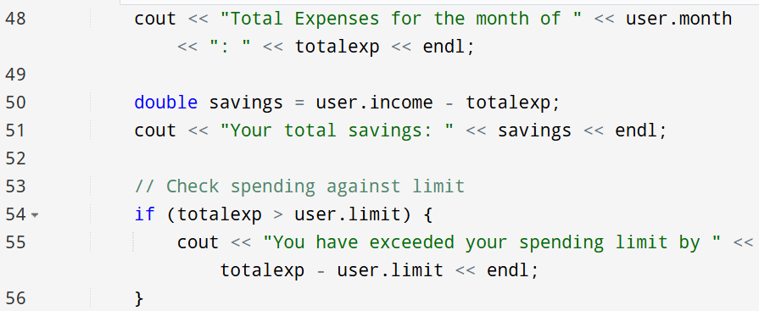
PROGRAM

Slide 14
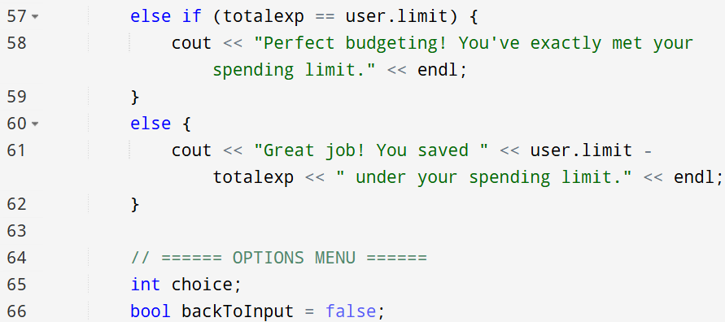
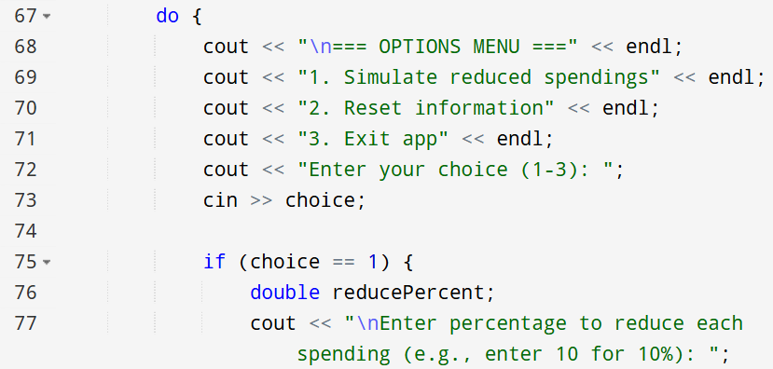
PROGRAM

Slide 15
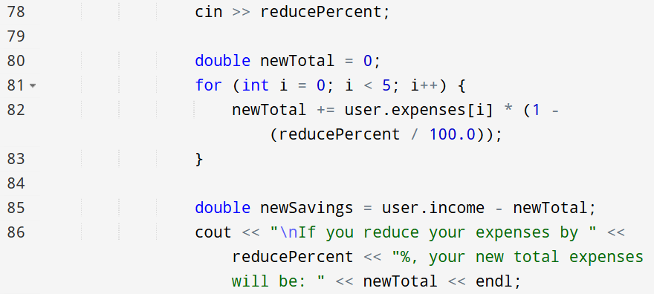
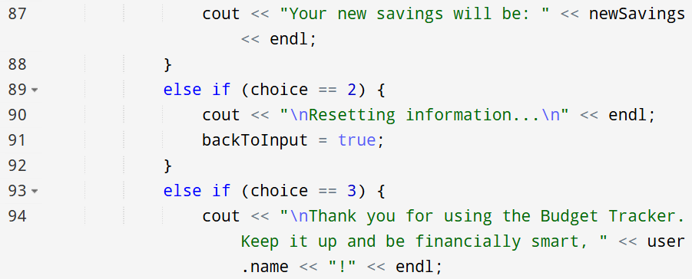
PROGRAM

Slide 16
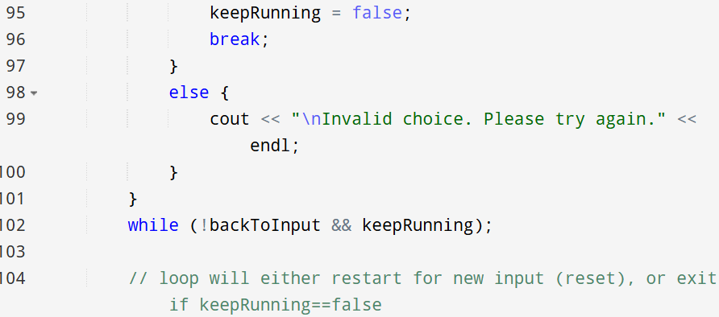
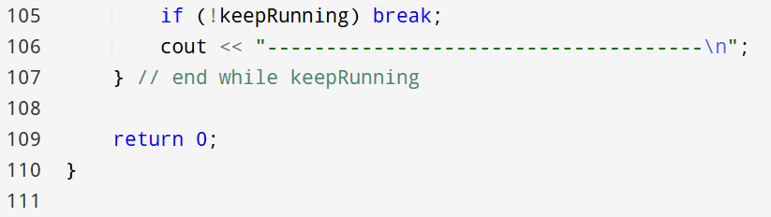
PROGRAM

Slide 17
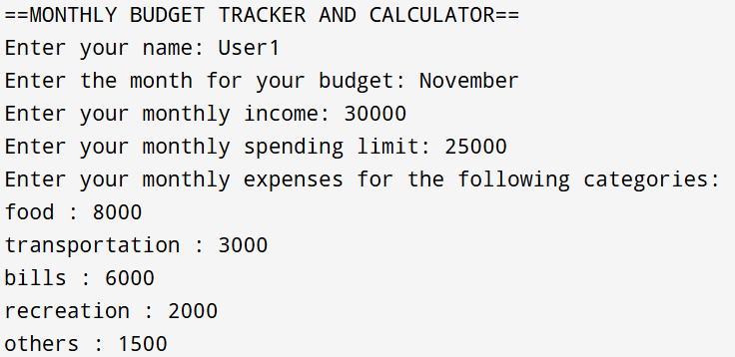
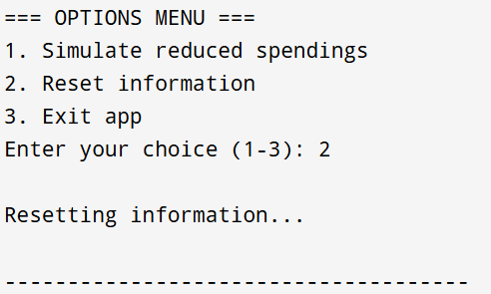
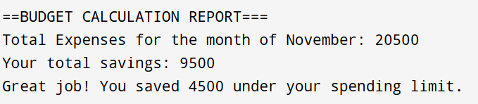

OUTPUTS

Slide 18

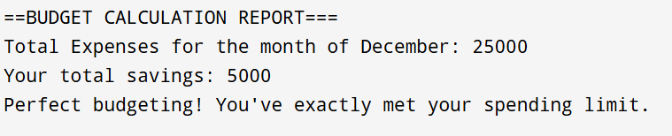
OUTPUTS

Slide 19
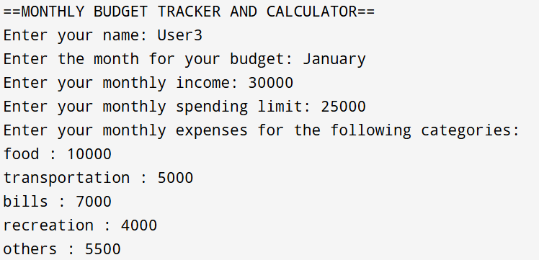
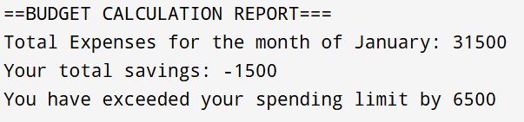
OUTPUTS

Slide 20
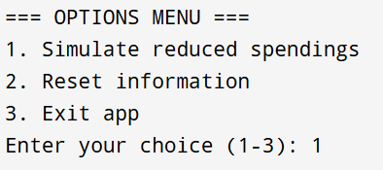
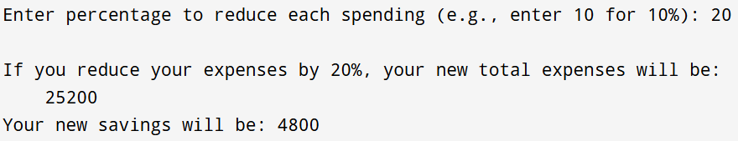
OUTPUTS

Slide 21
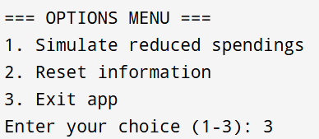
OUTPUTS

Slide 22
CONCLUSION
We created a C++ program that lets users input their monthly income, expenses, and spending limit and our program will calculate their total savings based on their expenses. Additionally, we also give them the option to simulate how much they could save if they were to reduce their expenses to a specified percentage. This will help people keep track of where their money is spent for the month and it can also help people better manage their expenses which creates an opportunity for them to efficiently manage their expenses and grow their savings

Slide 23

THANK
YOU
-

